Slide 1
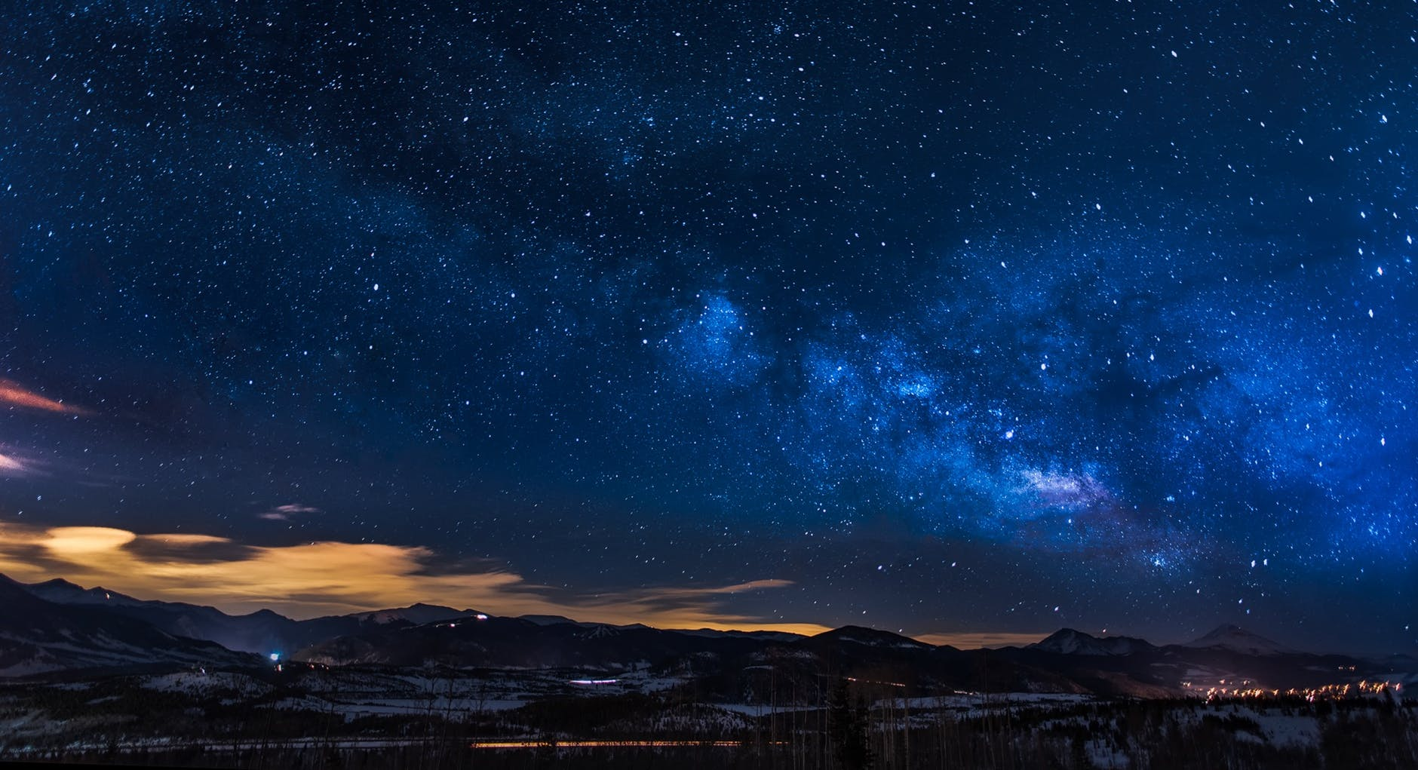
唠嗑

Slide 2
Academic Preparation
侯朋昆
18N2

Slide 3
Read the background guide
What to prepare
Make a motion list
Further research (on the country’s basis)
Speeches

Slide 4
Background guide

Slide 5
Introduction of the committee
委员会介绍
History of the problem
历史背景
In a background guide
Current situation
问题现状
Pact actions
曾采取的措施
Possible solutions
解决方案
You may see these in the content
Bloc positions
利益联盟
Questions need to be considered
值得考虑的问题

Slide 6
Introduction of the committee委员会介绍 | 介绍委员会的历史,使命,功能以及运作方式
Current situation问题现状 History of the problem历史背景 | 关于议题的介绍,包括问题的历史起源,发展过程,现状,全球/地区范围的影响等等
Pact actions曾采取的措施 | 历史上以及当前各国政府,联合国以及其他国家组织对该问题的反思和采取的措施及其正面/负面效果,有些背景材料会增加各国立场这部分
Bloc positions利益联盟 | 模拟会议中，除了国家利益之外，还要代表本国所在的国家集团（Bloc）的利益。 一国的利益或立场一般总是和国家集团有相似的地方，这点既可以启发小国的代表找准本国的立场，另外也可以提示各国代表去哪里寻找自己的盟友。

Slide 7
Possible solutions解决方案 | 主席团希望会议上通过的决议中涵盖的各个方面
Questions need to be considered值得考虑的问题 | 在会议的准备阶段应当思考的问题.代表需要仔细阅读背景材料,才能够知道该委员会具体要讨材料脚注,引用和参考文献论的哪些问题的哪些方面.同时,代表尤其要善于利用等信息,找到相关的信息与文件

Slide 8
Motion list

Slide 9
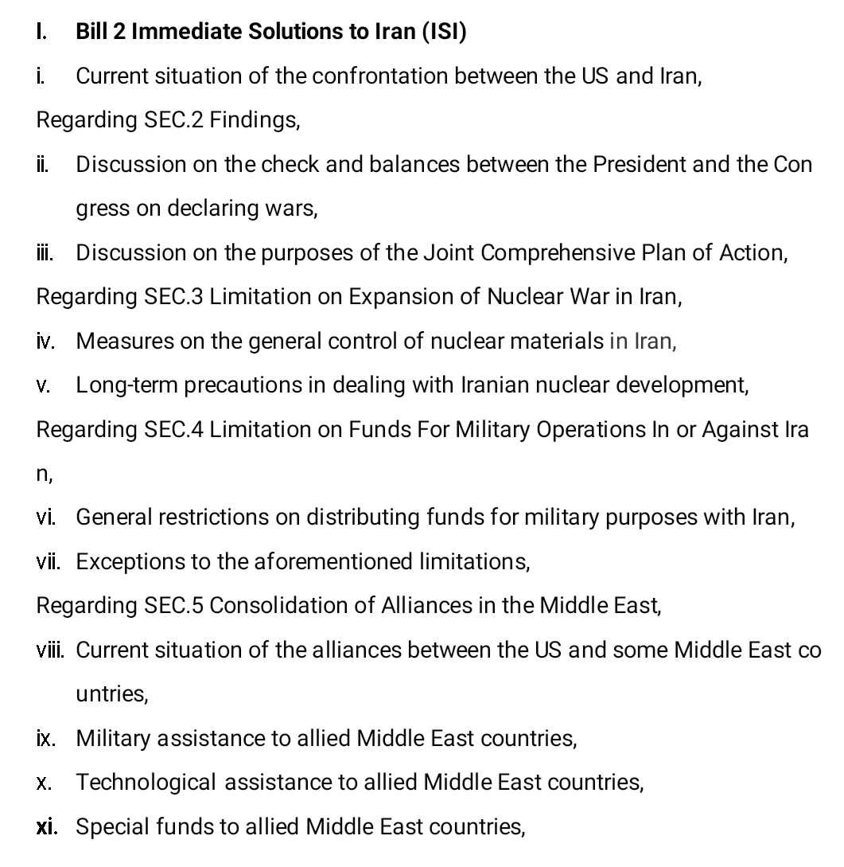
A motion list
It looks like this

Slide 10
How to do it
Motion list
Follow the background guide (pattern, questions)
Divide, divide and divide…(framework)

Slide 11
Further research

Slide 12
According to McClintock, a 15th Century
Country
What to research?
Physical geography
Cultural Geography
Political Geography
Economic Geography
“defined territory”
“permanent population”
“government”
“capacity to enter into relations with the other states”

Slide 13
Physical Geography
Country Research
What is your country’s official name?
What region of the world is your country located in?
How big is your country? (square miles)
Who are your country’s neighbors?
How would you describe your country’s physical features and climate?

Slide 14
Cultural Geography
Country Research
What is your country’s population?
What is your country’s ethnic composition?
What is your country’s official language?
What other languages are spoken?
What are some of the major cities?

Slide 15
Political Geography
Country Research
When was your country founded?
What type of government does your country have?
Who are some of your country’s leaders?
How many people serve in your country’s military?
Who are your country’s allies? Enemies?
What is your country’s capital?

Slide 16
Economic Geography
Country Research
How would you describe the quality of life in your country?
What is your country’s total Gross Domestic Product?
What are some of your country’s natural resources?
What is your country’s currency?
What are your country’s major imports and exports?
What are your country’s biggest trading partners?

Slide 17
Your Country Policy is what your country thinks should be done, or not done, about the issue, and how this topic impacts your country.
Country policies
This means determining if your country is in favor of solutions that have been proposed or resolutions that have been passed, or if your country has been advocating at the UN for policies.
What to research?

Slide 18
Committee
Mandate
History
Note
What to research?

Slide 19
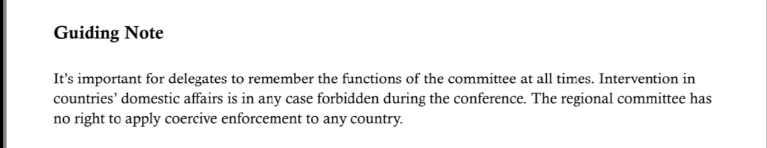

Slide 20
you should consider what your country wants the United Nations to do about the issue worldwide.
Possible Solutions
All resolutions should be realistic
What to research?

Slide 21
Past International Action
you want to make sure you’re aware what the world already has, and hasn’t done
Include: UN resolutions, international conventions and treaties, or actions by NGOs and international organizations
What to research?

Slide 22
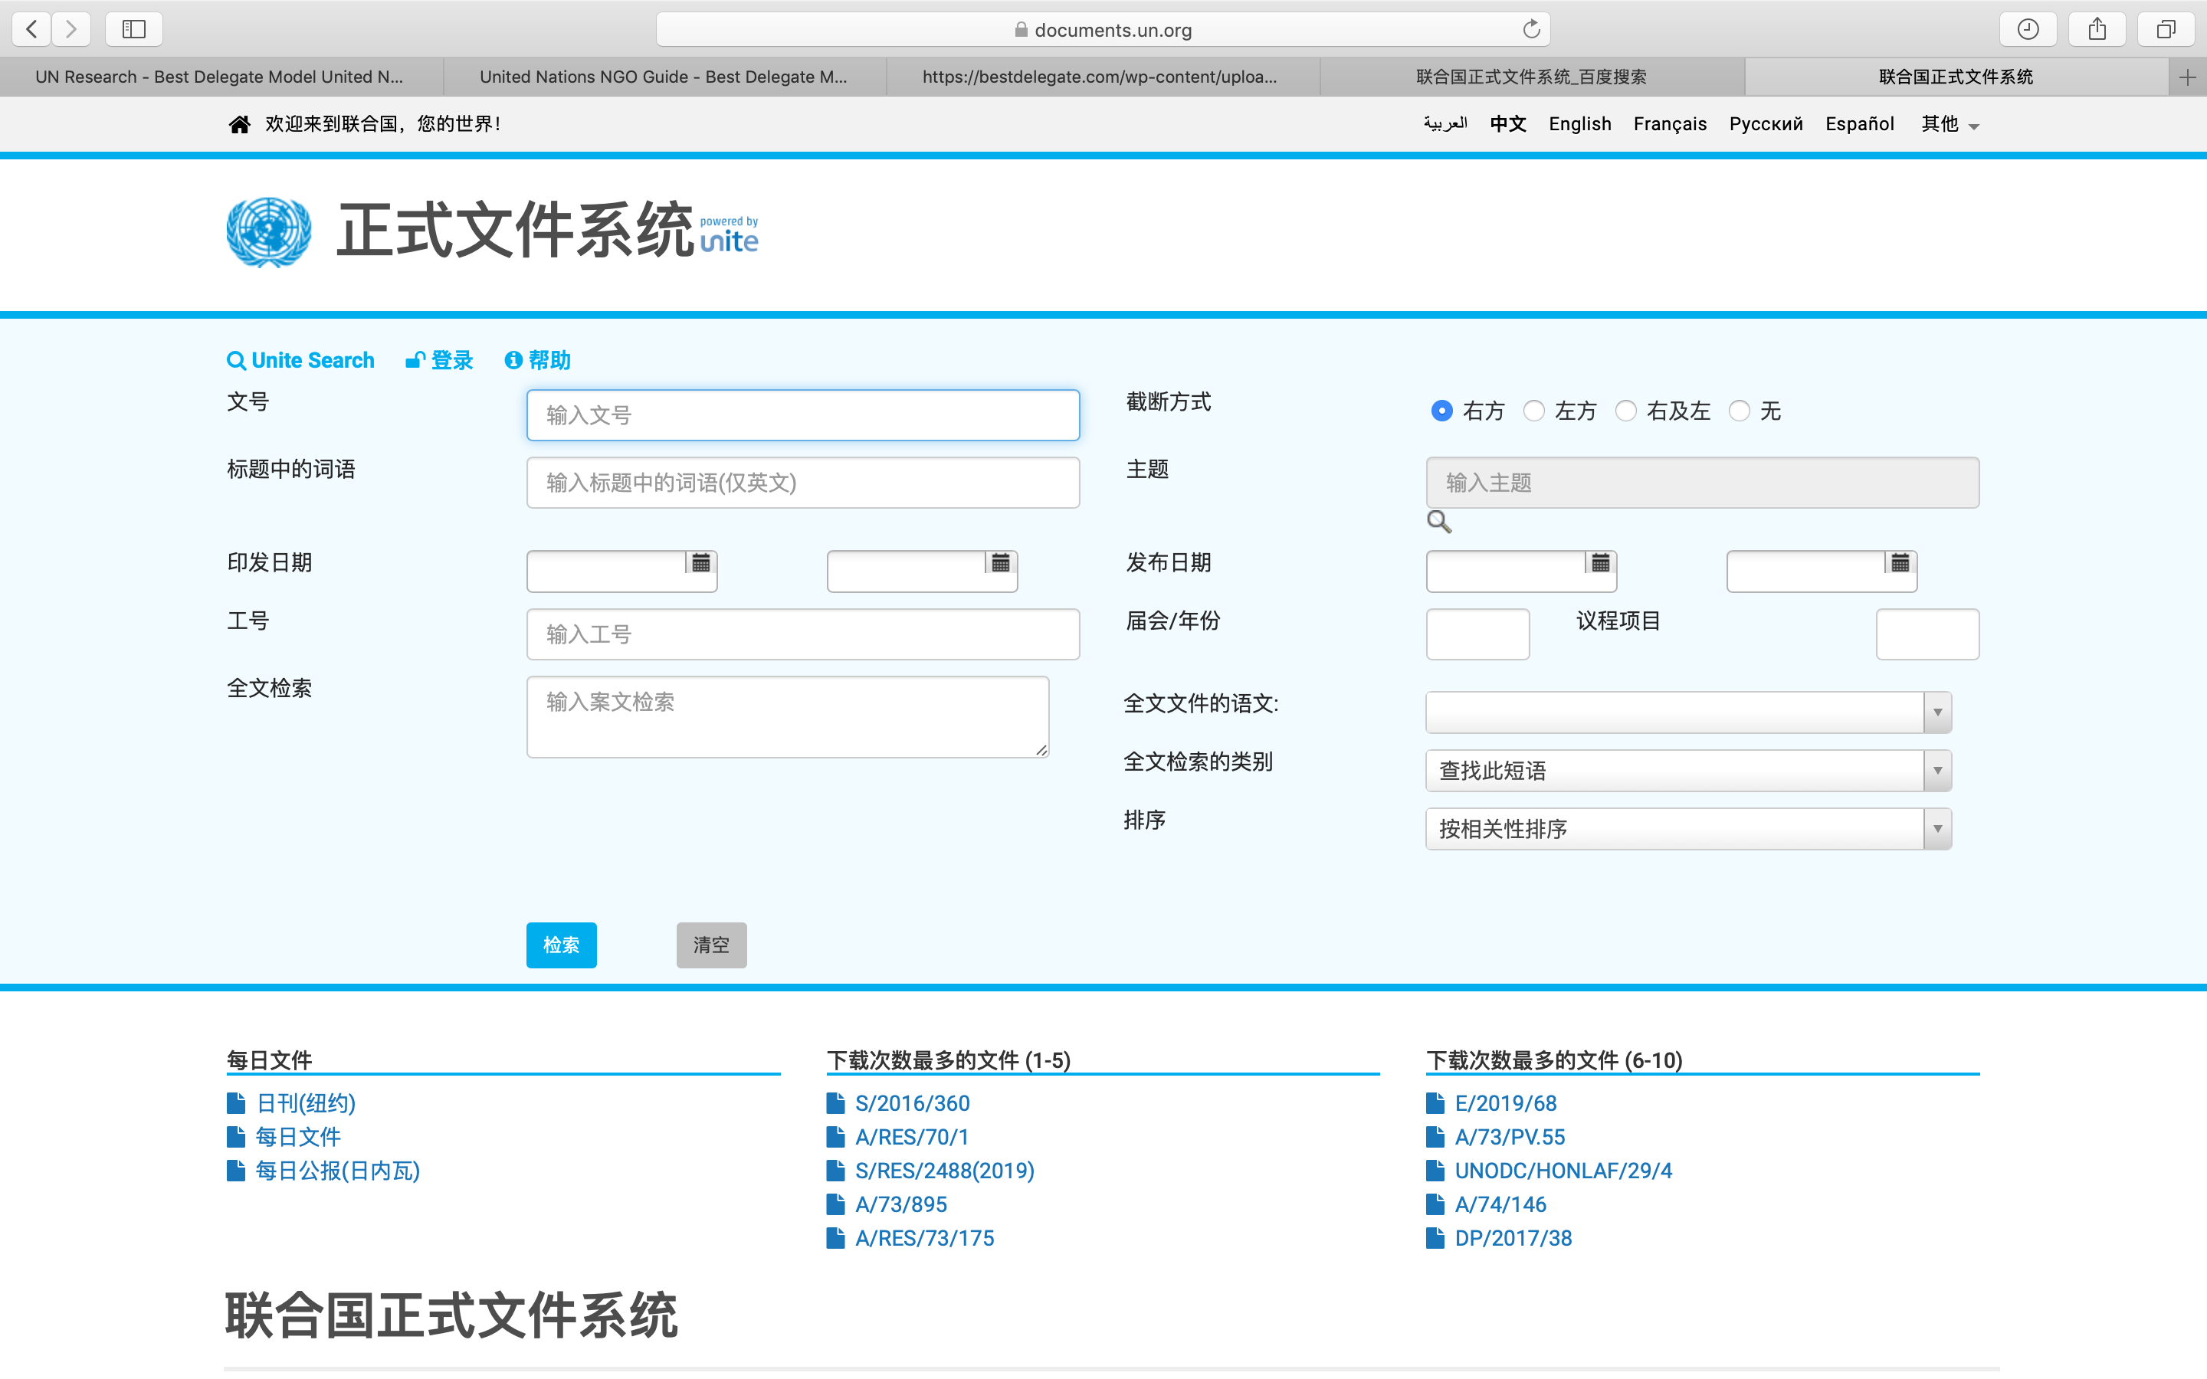
Where to research
https://documents.un.org/prod/ods.nsf/home.xsp
联合国的文件

Slide 23
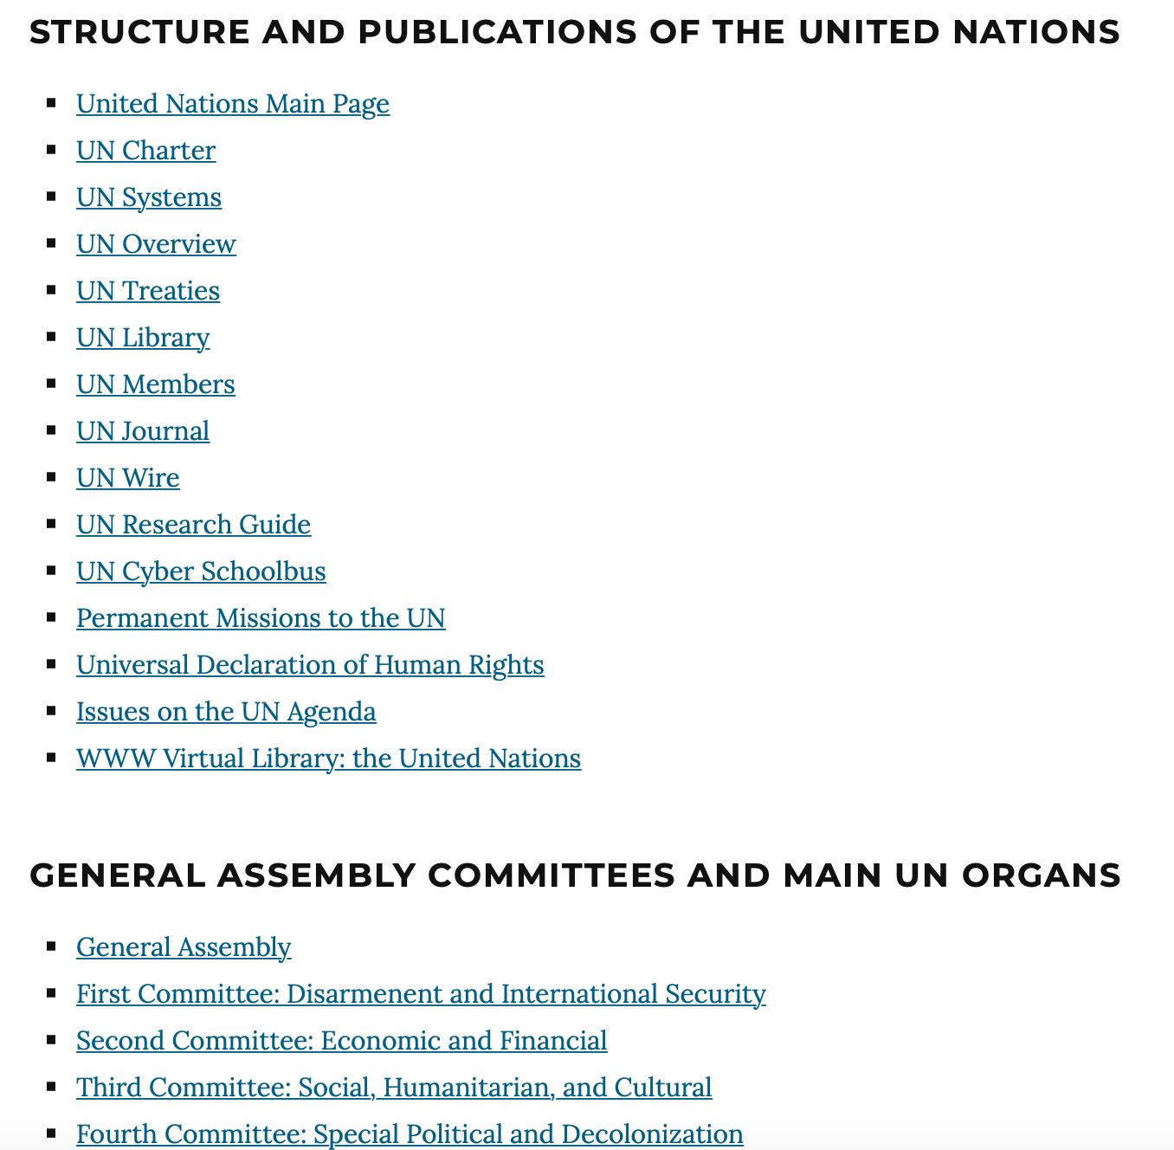
Where to research
https://bestdelegate.com/research/
你可能需要的网站的大汇总
及本次培训涵盖的相关知识
此网站可以用来做自行研究

Slide 24
Speeches

Slide 25
‘’
Honorable Chair and Distinguished delegates, this is the delegate of Greece.
(Entering) With the development of artificial intelligence technology rapidly developing, the advanced robotic weapon technology has been playing an increasingly significant role in modern warfare and triggering increasingly controversial arguments about it.
(Situation) Greece is recovering from a tough economy situation with most economic indicators improving and a hopeful prospect so that Greece will be more and more actively engaged on developing such weapons.
(Opinion) Regarding to the fact that "Some technologies are so powerful as to be irresistible", Greece is not expecting robotic weapons to be banned in general but wishing to establish international agreements and regulations on such weapons because Greece firmly believe that if robotic weapons are to utilized in a proper way, they can be very beneficial to human beings instead of destroying us.
(conclusion) Greece wishes the issues on the application of advanced robotic weapon technology could be solved well.
Thank you.
Main
Speaker’s
List
According to McClintock, a 15th Century
国家立场
‘’
请不要念你的立场文件

Slide 26
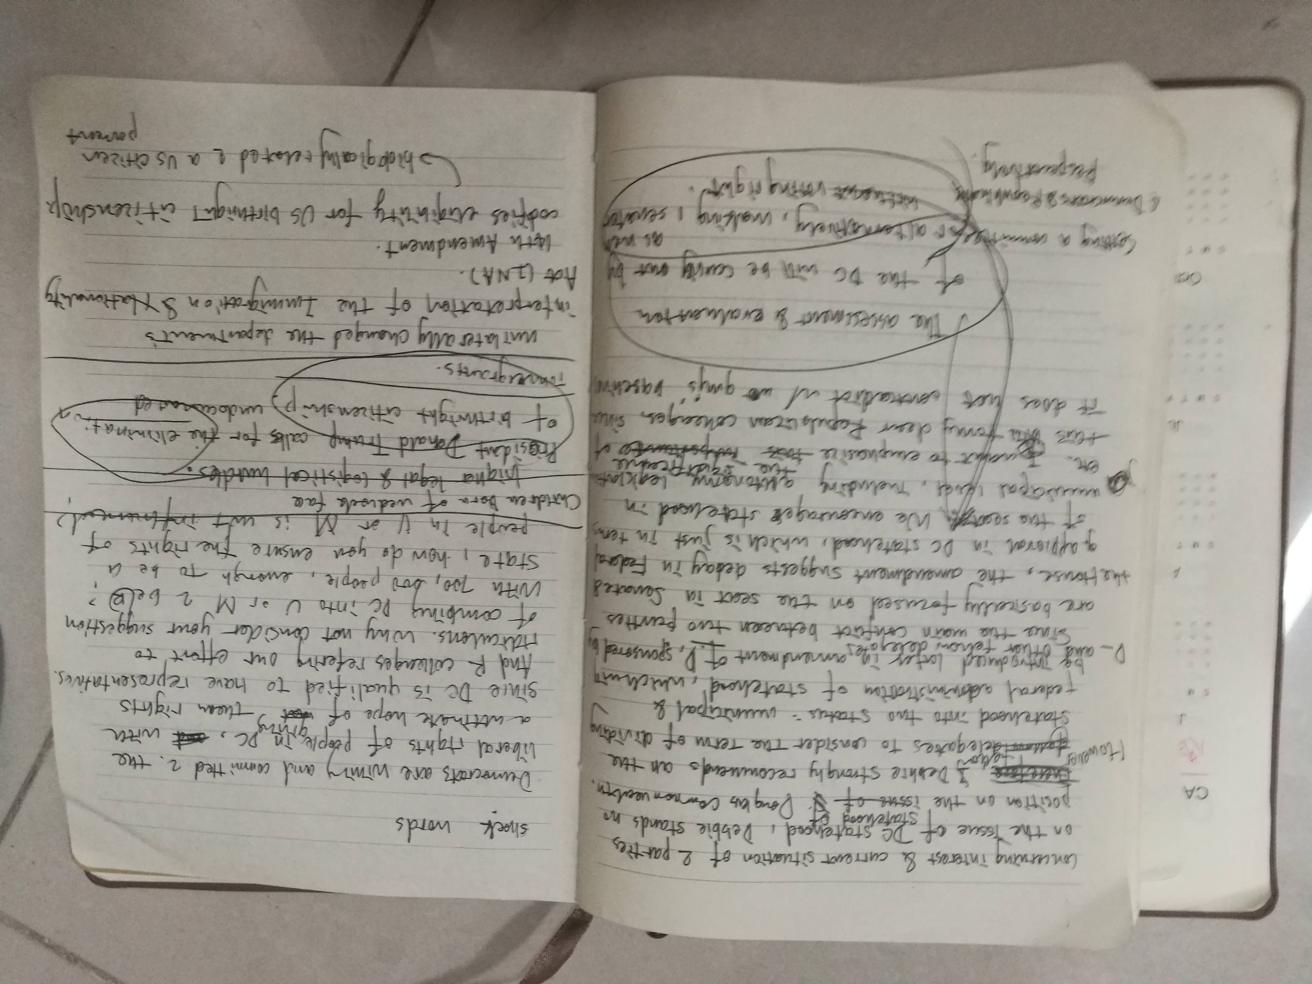
Moderated
Caucus
According to McClintock, a 15th Century
针对动议的立场
可根据议题拆分提前写好 或framework
清晰 明了 有感染力

Slide 27
整理调研结果
委员会调研
framework（motion list）
国家调研
若干联合国相关决议
若干条约/议定书/宣言/共同声明/公约/法案
立场文件
主发言名单演讲稿
若干有主持核心磋商演讲稿

Slide 28
Thank you!

